Slide 1



HAZARD PREVENTION SYSTEM USING GSM
DEPARTMENT OF ELECTRONICS AND COMMUNICATION ENGINEERING
BATCH NO:8
PRESENTED BY
GUIDED BY
JEGAN M - 21ECR089 JEGAN P - 21ECR090
MEIPRASAANTH V - 21ECR116
Mrs.V.MEKALA M.E.,
ASSISTANT PROFESSOR(SR.G),
DEPARTMENT OF ECE.
KEC
DATE: 13.05.24
THIRD REVIEW

Slide 2

INTRODUCTION
Saarathi
Animal Feeds is one of the
cattle feed manufacturing company,
located in Siruvalur near
Gobichettiplayam.
●
They produces feed in the form of
pellets at different qualities and
distributes to various parts of
tamilnadu.

Slide 3
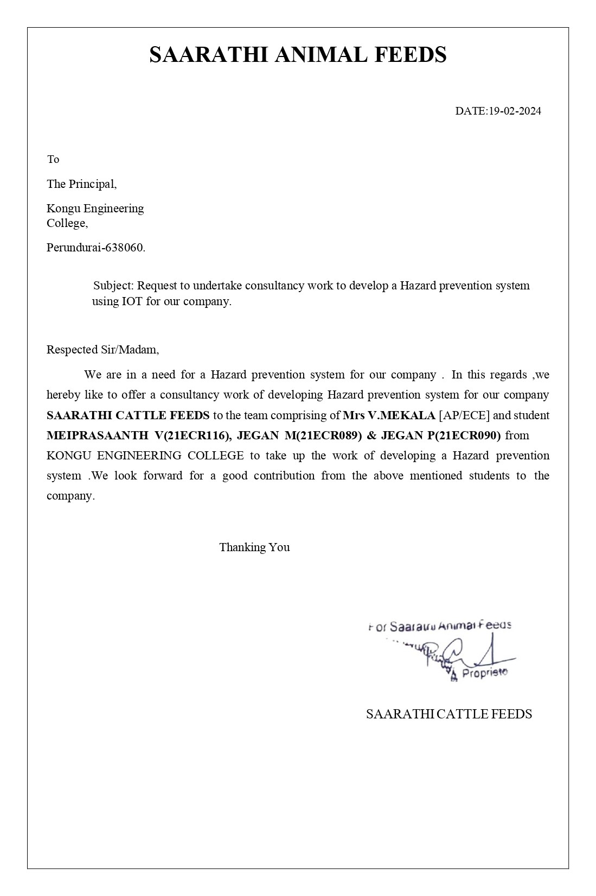
ACCEPTANCE LETTER

Slide 4
PROBLEM STATEMENT
The problem statement for Saarathi Cattle Feeds is the critical need for safety system in their storage unit.
Current safety protocols relying on manual monitoring are inadequate, increasing the risk of accidents, injuries, and operational disruptions.
Without real-time environmental surveillance, there's a significant gap in detecting potential hazards such as temperature fluctuations and hazardous gas emission.

Slide 5
OBJECTIVE
The main objective of this project is to develop and implement a Hazard Prevention System using GSM technology in their storage unit. This safety system aims to monitor temperature and gas levels in real- time environment.

Slide 6
TECHNOLOGY AND TOOLS
TECHNOLOGY:
GSM Technology
GSM 800L
Sensor Technology
MQ – 2 (Gas sensor)
LM35 (Temperature Sensor)
LDR (Light Sensor)
Emergency alert system
LCD I2C Display
LED
Alarm (Buzzer)
TOOLS:
Development Board
Arduino UNO
Software
Arduino IDE
Proteus 8 Professional

Slide 7











BLOCK DIAGRAM
Power Supply
LCD Display
INPUT MODULE
OUTPUT MODULE
ARDUINO
UNO
Temperature Sensor
Buzzer
Light Sensor
GSM Module
Gas Sensor
Load(Light)

Slide 8
COMPONENTS AND ITS SPECIFICATIONS
COMPONENTS | SPECIFICATIONS | USAGE
Arduino UNO | Operating Voltage 5V, Input Voltage 7-12V, Digital I/O Pins 14 , Analog Input Pins 6, Flash Memory 32KB, SRAM 2KB, EEPROM 1KB, Clock Speed 16MHz. | Gets the input data from sensor and responds to it.
LCD Display | Typically 16x2 character configuration,I2C Interface operates at 5V. | Shows the real time sensor readings.
I2C Module | Communication Interface | Generates communication between Arduino and LCD display.
LM35 (Temperature Sensor) | Analog temperature sensor, accuracy ±0.5°C, operating range -55°C to 150°C | Temperature monitoring and control systems.
MQ-2 (Gas Sensor) | Detects multiple gases, including LPG, propane, methane, and smoke, with analog output, operating voltage 5V. | Fire detection systems, industrial safety monitoring, air quality monitoring.
LDR (Light Sensor) | Operating Voltage 5V-10V, Resistance range from several kilo-ohms to several mega-ohms. | Automatic Lighting Control, Photographic Light Meters, Solar Panels, Burglar Alarms,Automatic Street Light Control
GSM Module | Enables cellular communication, operates at 5V, supports standard AT commands. | Remote monitoring systems, GPS tracking devices, SMS-based alert systems.

Slide 9
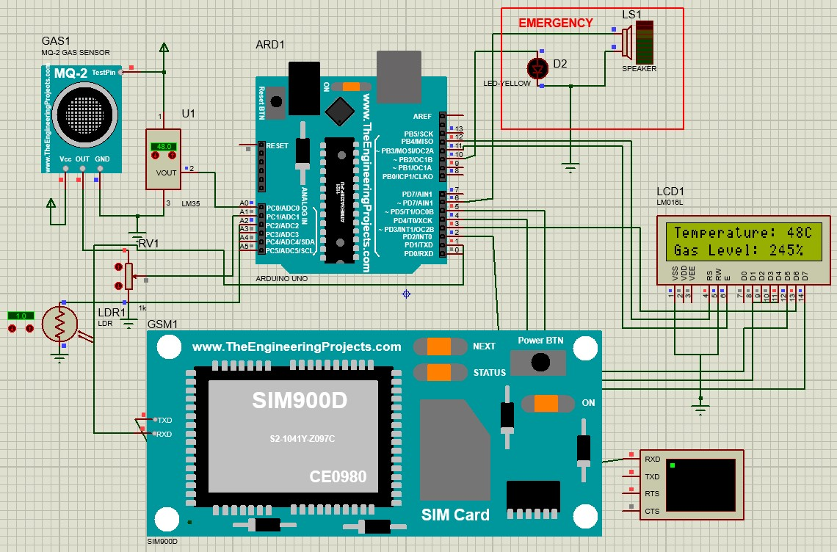
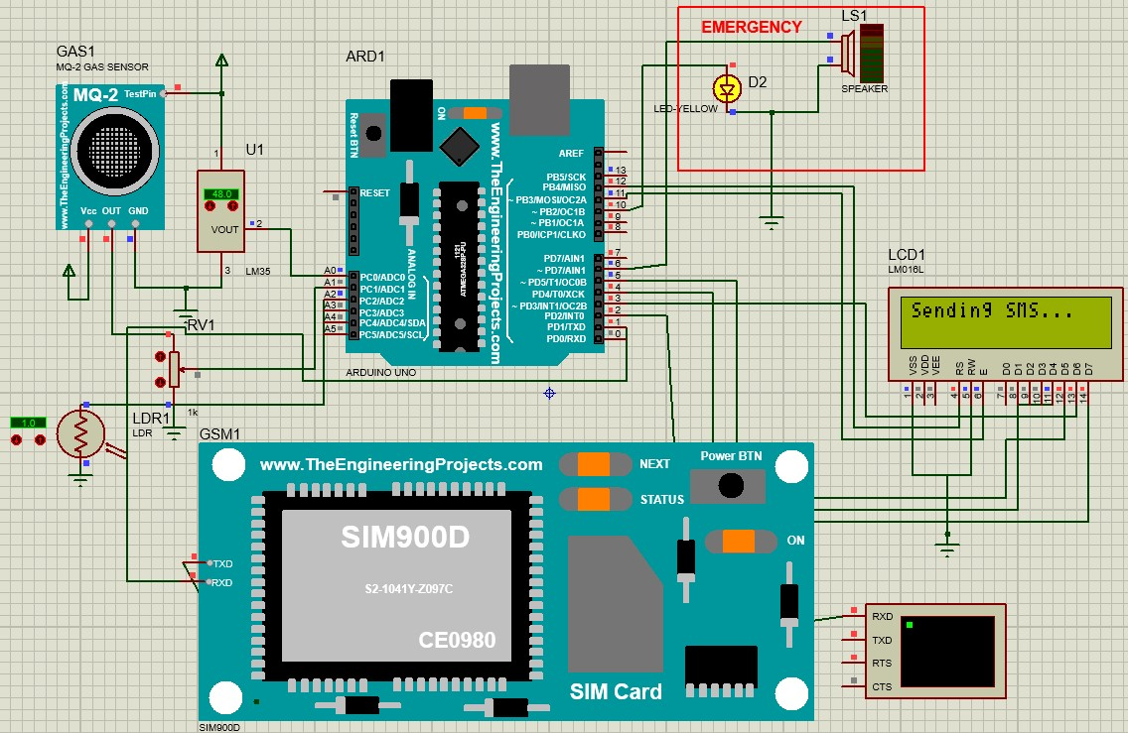
SIMULATION
Under normal condition (i.e., when no hazard is detected)
Message send through GSM (When hazard is detected)

Slide 10
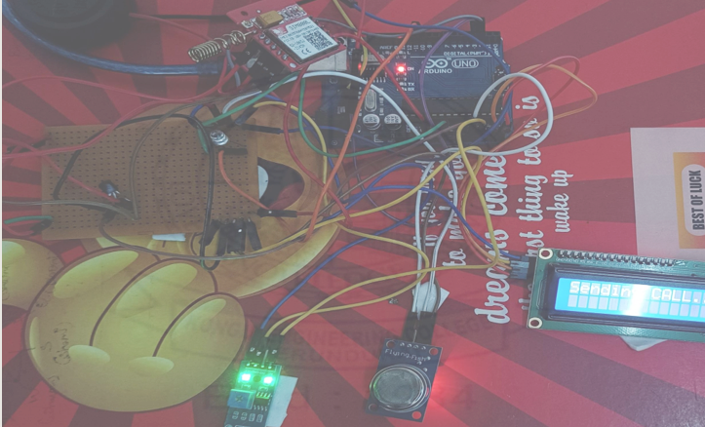
DEMO PROTOTYPE

Slide 11
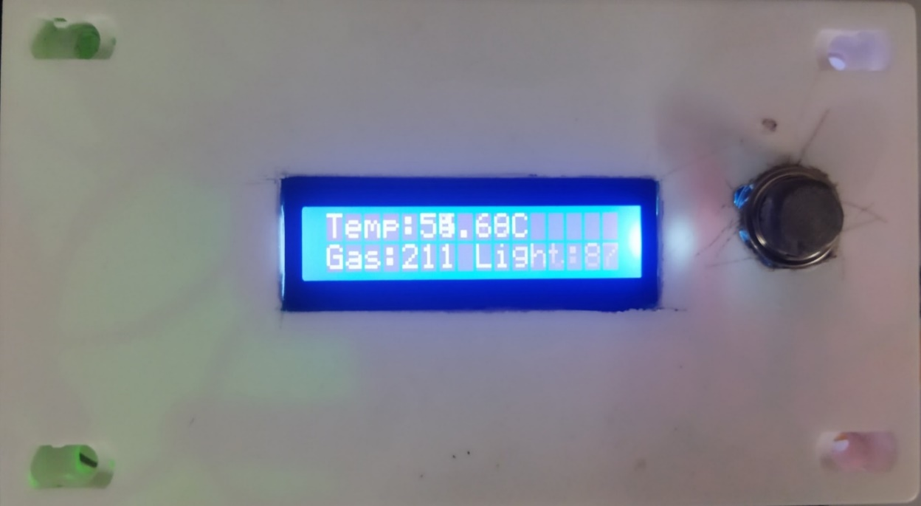
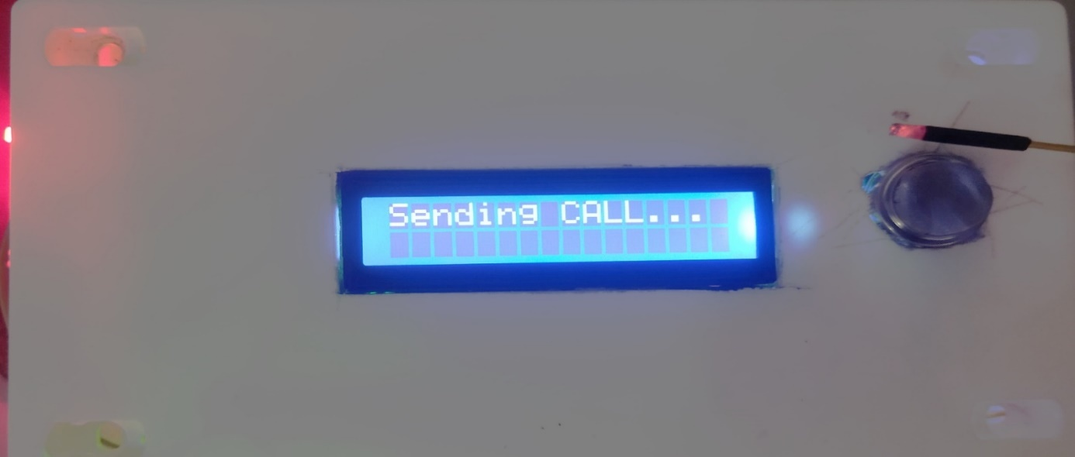
FINAL PROTOTYPE
Under normal condition (i.e., when no hazard is detected)
The hardware output of hazard prevention system using GSM, under normal condition (i.e., when no hazard is detected) LCD displays the real time temperature, light intensity and gas level.
Message send through GSM (When hazard is detected)
The hardware output when sensor values exceed predefined threshold levels, the hazard prevention system triggers an immediate response through GSM communication and also through buzzer, LED and LCD display. In such instances, the system initiates a series of actions to alert users and ensure timely intervention

Slide 12
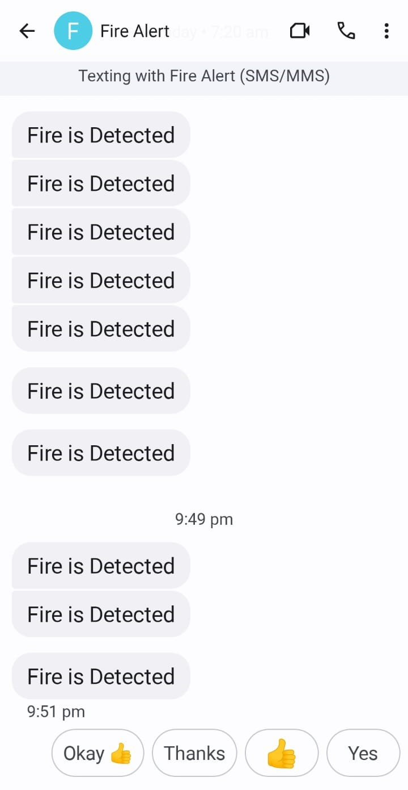
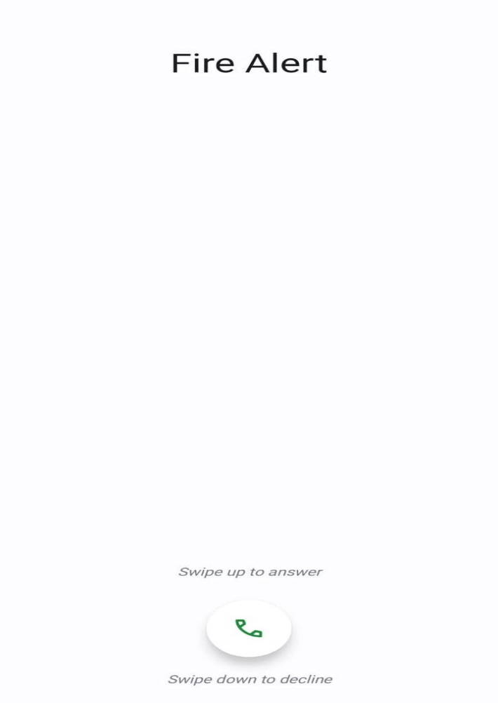
Hazard Alert System
The alert system which includes the alert message and call received by the fire safety department and the respective owner of the company when any hazard occurs within the storage unit of the company.

Slide 13
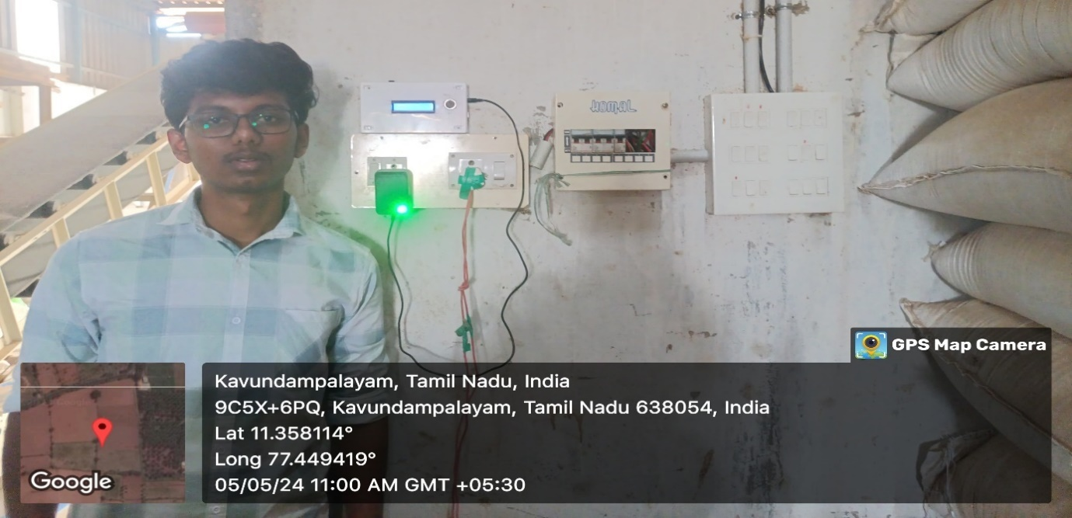
IMPLEMENTATION
Video Link:
https://drive.google.com/drive/folders/1vhymKZiuXCBayVEtJdLQbBvI3WsOITDm

Slide 14
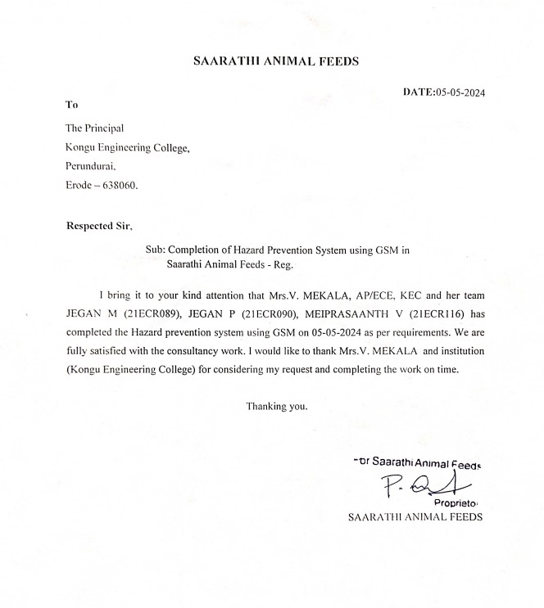
APPRECIATION LETTER

Slide 15
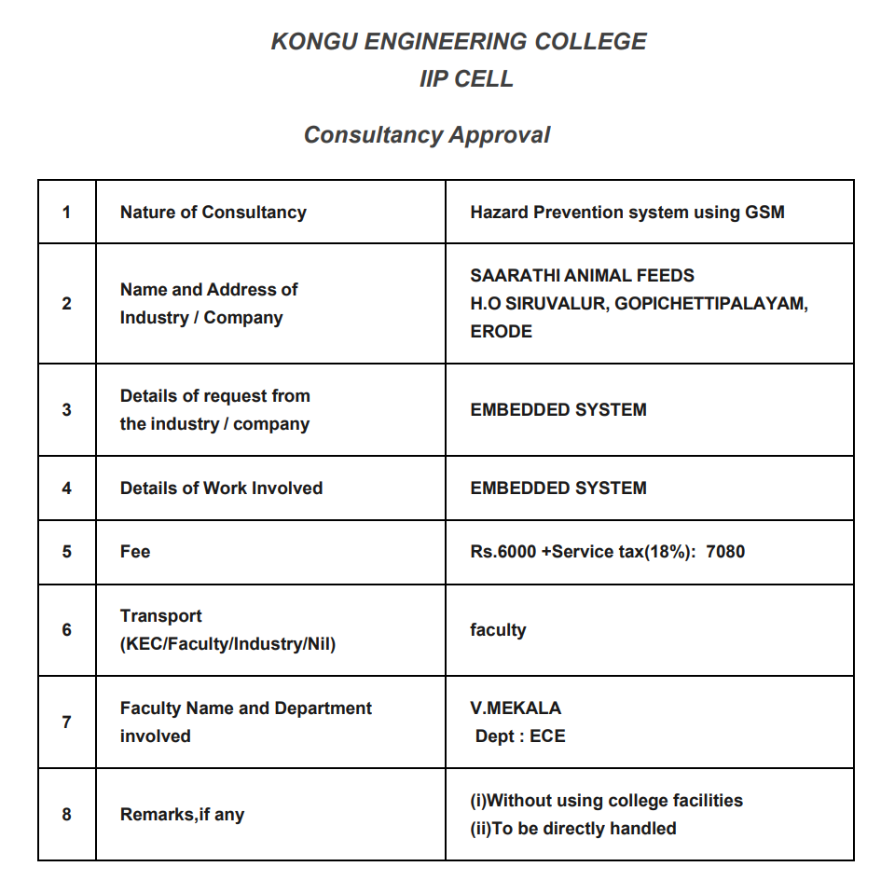
IC01 FORM

Slide 16
REFERENCES
Göbl, M., & Hofmann, M. (2021). IoT-Based Hazard Monitoring in the Industry 4.0 Environment. In Smart Systems Integration and Simulation (pp. 125-143). Springer, Cham.
Legros, G., Havet, I., Beaugency, L., Ramalli, A., Roncin, P., Al-Najjar, G., & Périé, S. (2019). Hazard prevention management in the context of the Fourth Industrial Revolution. Journal of Loss Prevention in the Process Industries, 62, 103938.
Radovic, D., Knezevic, S., & Stojanovic, G. (2020). The Role of Information Technology in the Improvement of Occupational Safety and Health in Industry 4.0. International Journal of Environmental Research and Public Health, 17(2), 447.
Sharma, S., & Pant, M. (2020). IoT-based Monitoring and Control System for Hazardous Gas Detection in Industries. In 2020 International Conference on Smart Electronics and Communication (ICOSEC) (pp. 630- 634). IEEE.

